Slide 1


Collection Efficiency & Employee Productivity
A detailed exploration of collection effectiveness and employee productivity.
by Dipali Shah

Slide 2
Project Overview
Objective
Approach
Analyze collection effectiveness and employee productivity.
Transform, clean, load, and visualize data using Power BI.

Slide 3

Key Data Sources
1
Attrition Data
2
Portfolio Data
3
Collection Data
Employee turnover trends (May-Aug 2024).
Loan details (amount, interest, repayment).
Loan performance (repayments, overdue).

Slide 4
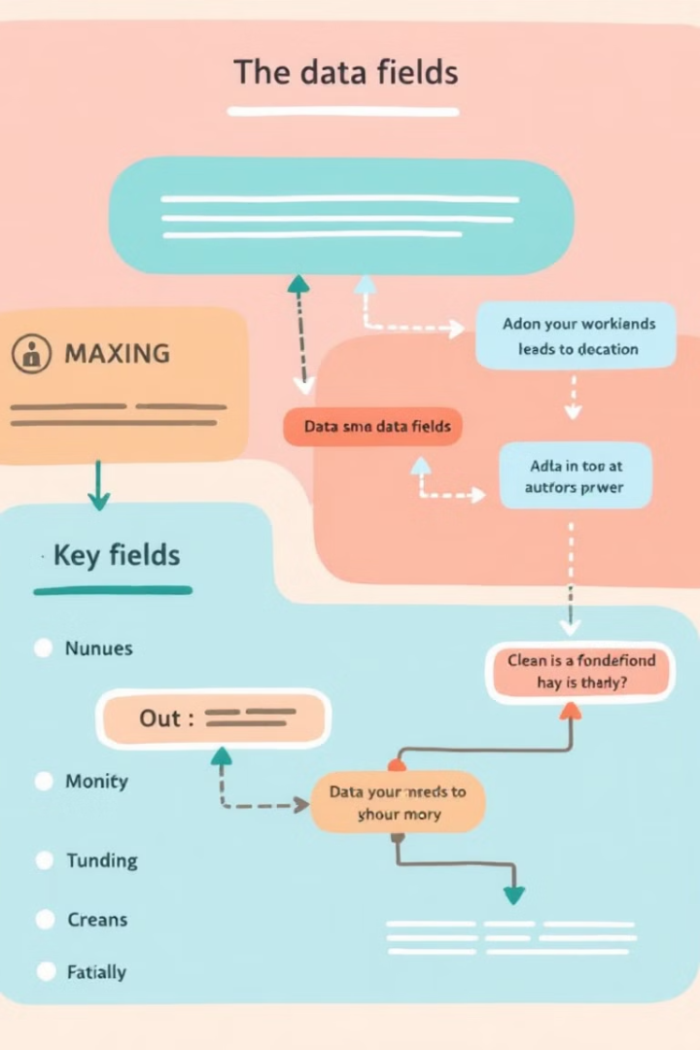



Key Data Fields
Attrition Data
Portfolio Data
Collection Data
Branch, joiners, exits, transfers, balance.
Client ID, loan amount, disbursed date, overdue amounts.
Loan ID, demand, collection, OD collection.

Slide 5
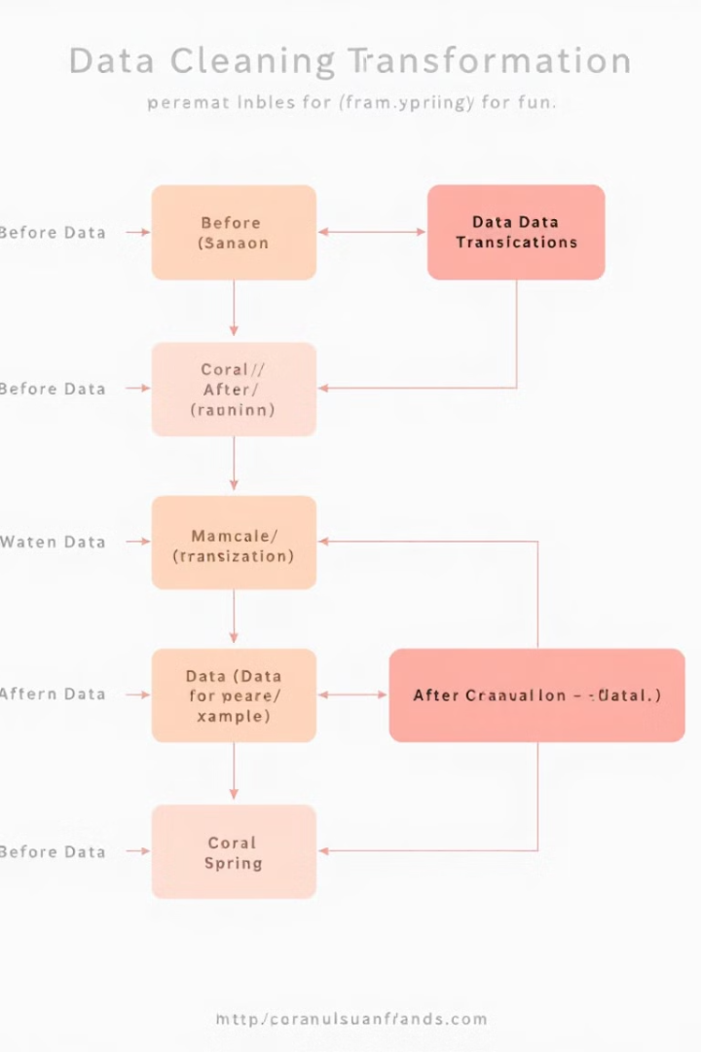




Data Transformation & Cleaning
Standardize Dates
YYYY-MM-DD.
Unify Codes
Branch codes across datasets.
Handle Missing
Imputation/removal.
Ensure Consistency
Client & Loan IDs.

Slide 6



Data Relationships
Loan ↔ Collections
Client ID, Loan ID.
Employee ↔ Collections
Employee ↔ Loan
Branch Code, Date.
Branch Code, Date.
2
1
3

Slide 7
Automation Process
Jupyter Notebook
1
Initial data cleaning.
Apache Airflow
2
Automating cleaning & loading.
MSSQL
3
Storing cleaned data for Power BI.

Slide 8
Power BI Dashboard Design
Loan Collection Analysis
Employee Productivity Analysis
KPIs, charts, branch performance.
Attrition rate, productivity score.
This presentation outlines the process of analyzing collection effectiveness and employee productivity using data from various sources. We will cover data understanding, transformation, cleaning, and loading into MSSQL, culminating in a Power BI dashboard for visualization and insights.

Slide 9
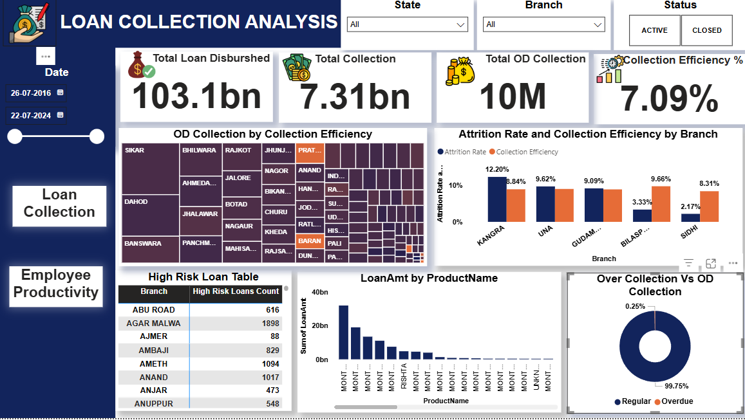
Loan Collection Analysis
.

Slide 10
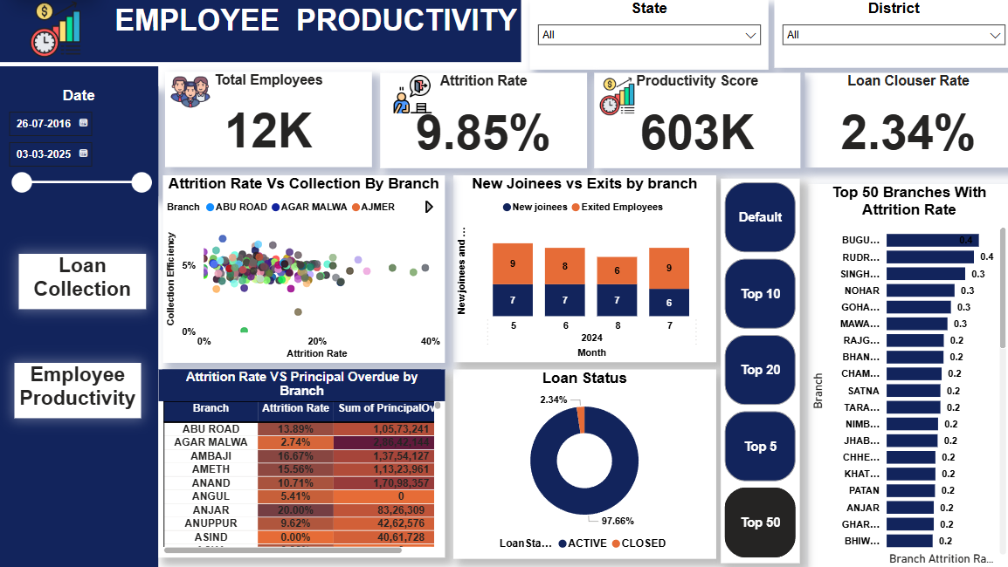
Employee Productivity Analysis

Slide 11
Loan Collection Analysis – Key Insights & Actions
📌Key Observations:
Low Collection Efficiency (7.09%) despite high loan disbursement (103.1bn vs. 7.31bn collected).
High-Risk Loan Branches require targeted recovery strategies.
Overdue Collection is high in specific branches, indicating repayment issues.
✅ Action Plan:
Automate follow-ups & reminders for overdue loans.
Strengthen loan approval & risk assessment to reduce high-risk loans.
Implement real-time tracking & incentives for improved collection performance.

Slide 12
Employee Productivity – Key Insights & Actions
📌Key Observations:
High Attrition (9.85%) affects collection efficiency.
Low Loan Closure Rate (2.34%), leading to prolonged outstanding loans.
Unstable Hiring Trends, with some months seeing more exits than joiners.
✅ Action Plan:
Introduce performance-based incentives & training to retain employees.
Improve loan processing & follow-up to boost closure rates.
Ensure balanced hiring to maintain workforce stability.

Slide 13
Thank You!
📊 Collection Analysis & Employee Productivity
🔹 Presented by: Dipali Shah
🔹 Optimizing Collections & Workforce Efficiency Through Data Analytics
💡 Key Technologies: Power BI | Apache Airflow | MSSQL | Jupyter Notebook
🚀 Driving Data-Driven Decisions for Business Growth
📩 For Queries & Discussions: [dipalinshah86@gmail.com]
🔗 Let’s Connect & Explore More Insights!

